Slide 1



Slide 2
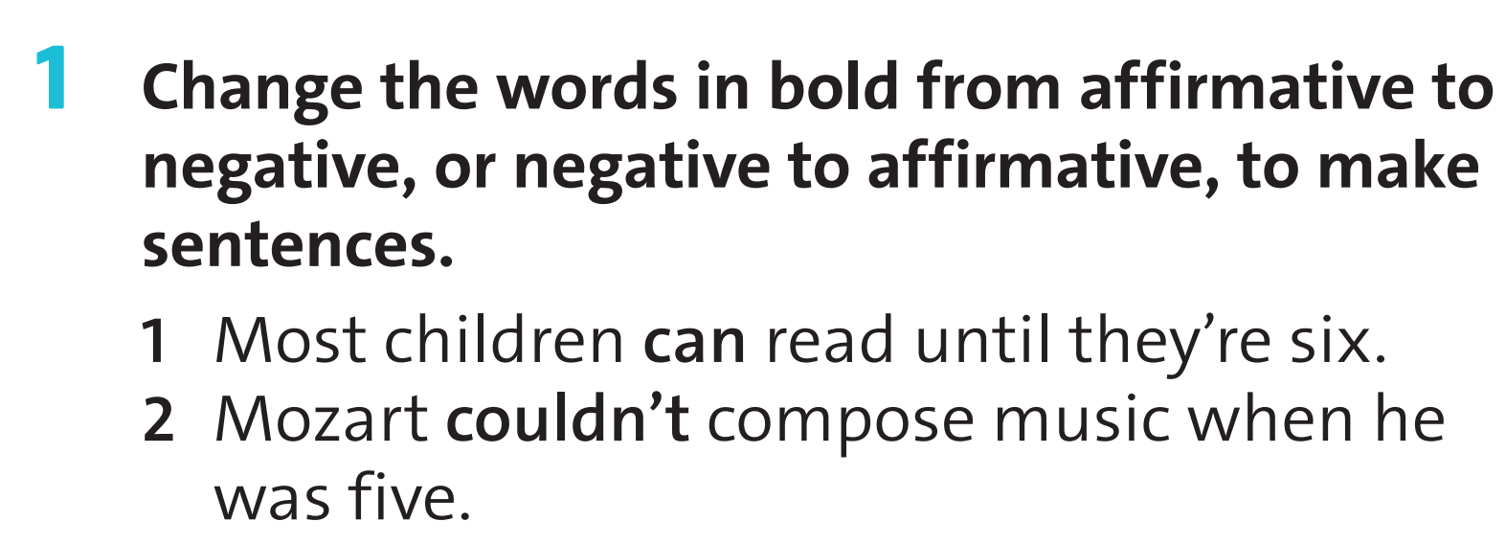
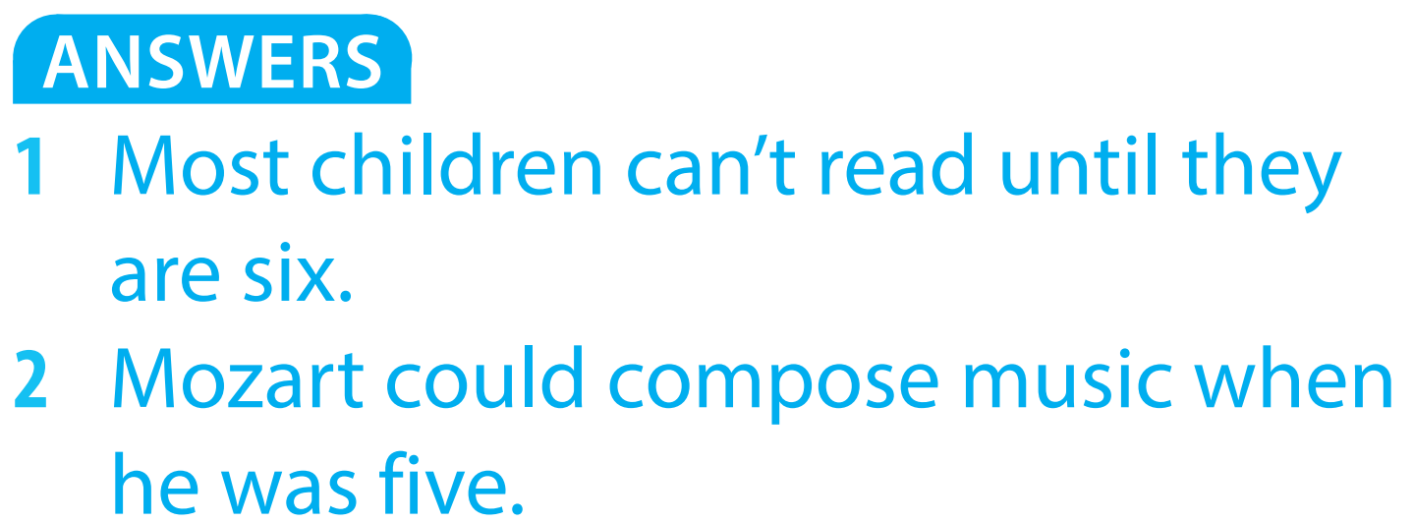

Slide 3
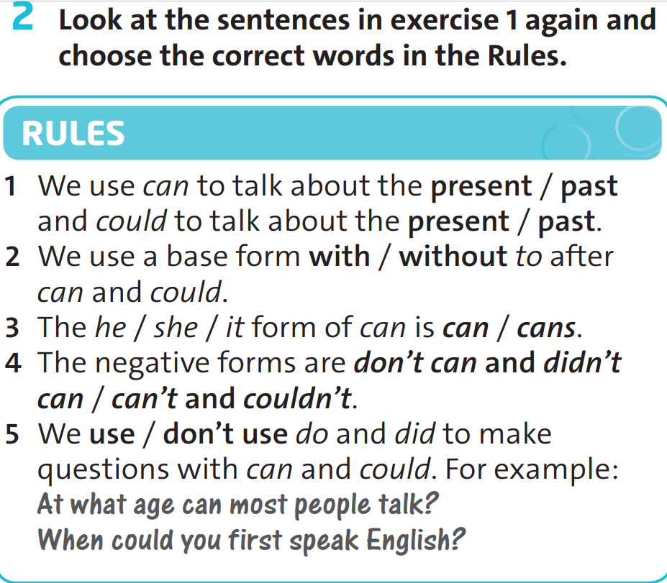

Slide 4


can
can’t
can’t
could
could
couldn’t

Slide 5
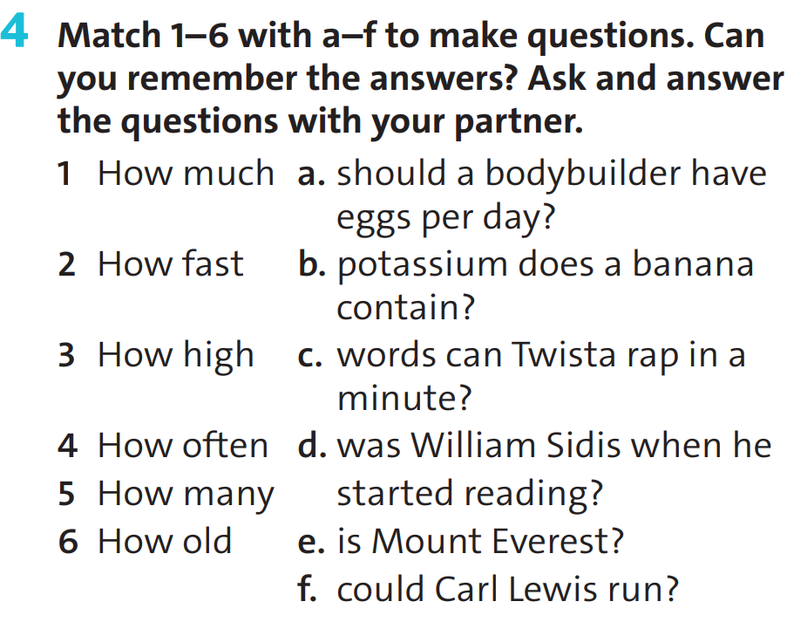


Slide 6
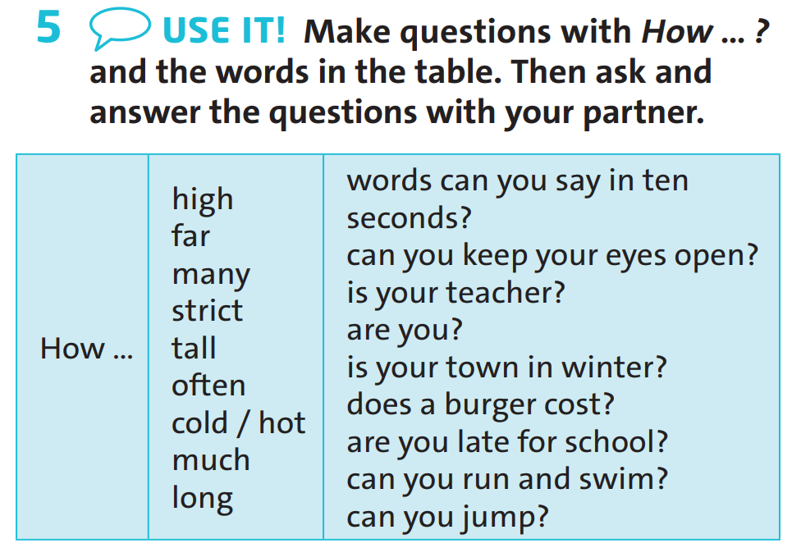

Slide 7

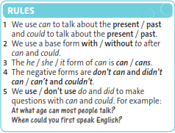
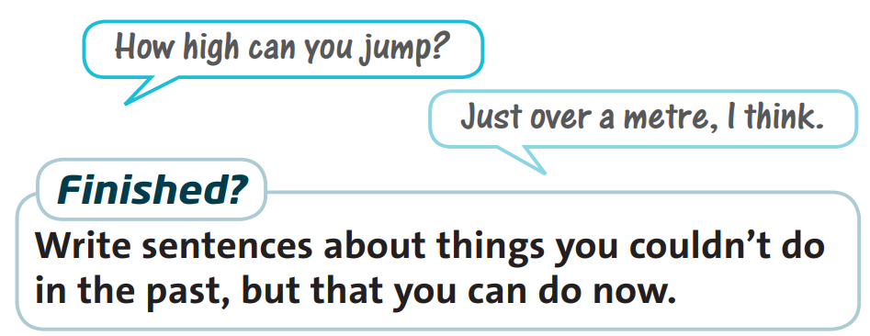
HOW + ADJ (N)/ ADV + Aux V + S + Ord V ?

Slide 8
Homework
Review the lesson
Do exercises in workbook p.34
Prepare next lesson

